Slide 1
Prescription Pain Pills in California
David Jaimes
Steven Quitugua

Slide 2
Motivation
Analyze current prescription drug epidemic
Data after 2015 not released to public because of ongoing investigations
Increased lawsuits towards big Pharma companies
Understanding of how the opioid epidemic affects us locally
Understand the relationship between income and death rates
150 people die a day from opioid overdose
Cities paying 200 million a year to keep up with the increased death rates

Slide 3
Hypothesis
If income and pill saturation are related, then concentrations greater than 73 pills per person per year and incomes greater than $40,000 yield higher death rates.
Income: Adjusted gross income per tax return
“73 Pills” is the mean for the state of California
“$40,000” is the large enough sample from the population

Slide 4
Data Collection
Population
State of California Department of Finance 2010
Death Rates
California Department of Public Health 2010
California Opioid Overdose Surveillance Dashboard
Income
State of California Department of Finance 2010
Number of Pills
Drug Enforcement Agency
Automation of Reports and Consolidated Orders and System (ARCOS)
Washington Post
Drilling Into the DEA’s pain pill database

Slide 5

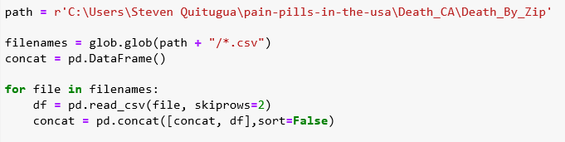
Clean up
U.S. data had 90 GB .csv file, whereas California’s data was 6 GB
“chunksize” parameter to read 200,000 rows at a time as opposed to all at once
Utilizing “glob” to combine multiple csv files into one variable

Slide 6
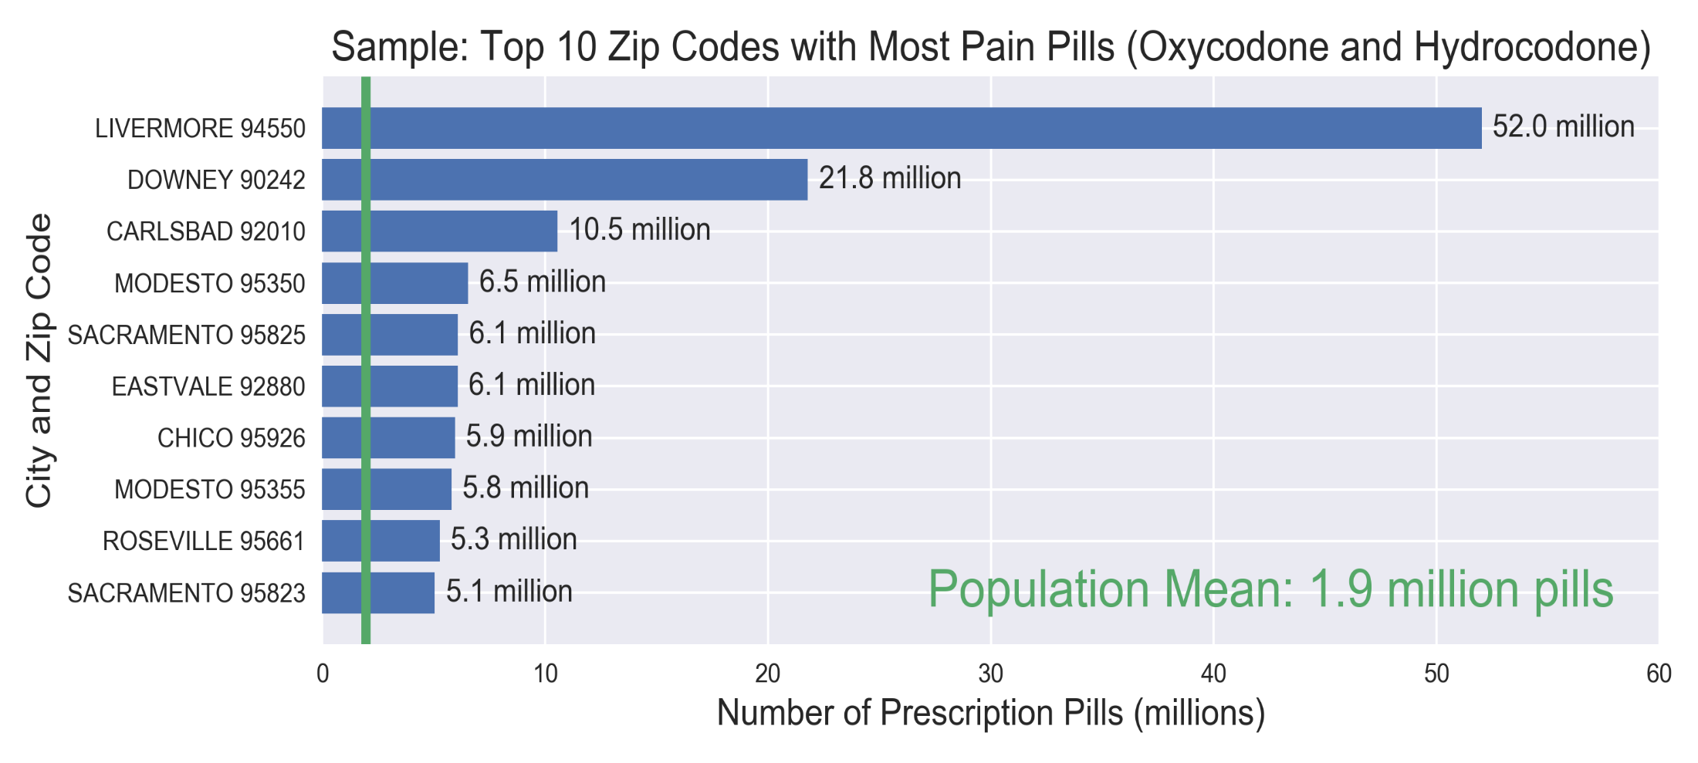
Top Ten Cities with the most pills

Slide 7
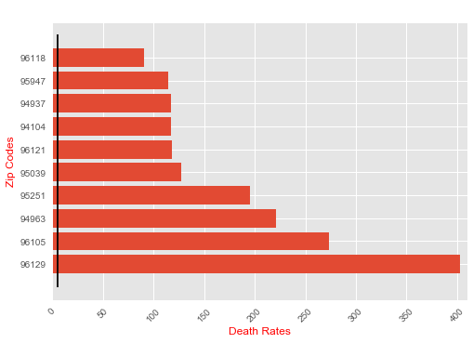
Top Ten Cities with the Highest Death Rate

Slide 8
Top Ten Cities with Most Pills Per Person

Slide 9
Title and Content Layout with SmartArt
Step 1 Title
Step 2 Title
Task description
Task description
Task description
Task description
Task description
Task description
Task description
Step 3 Title
Task description
Task description
Step 4 Title
Task description
Task description

Slide 10
Add a Slide Title - 1

Slide 11
Add a Slide Title - 5

